Slide 1
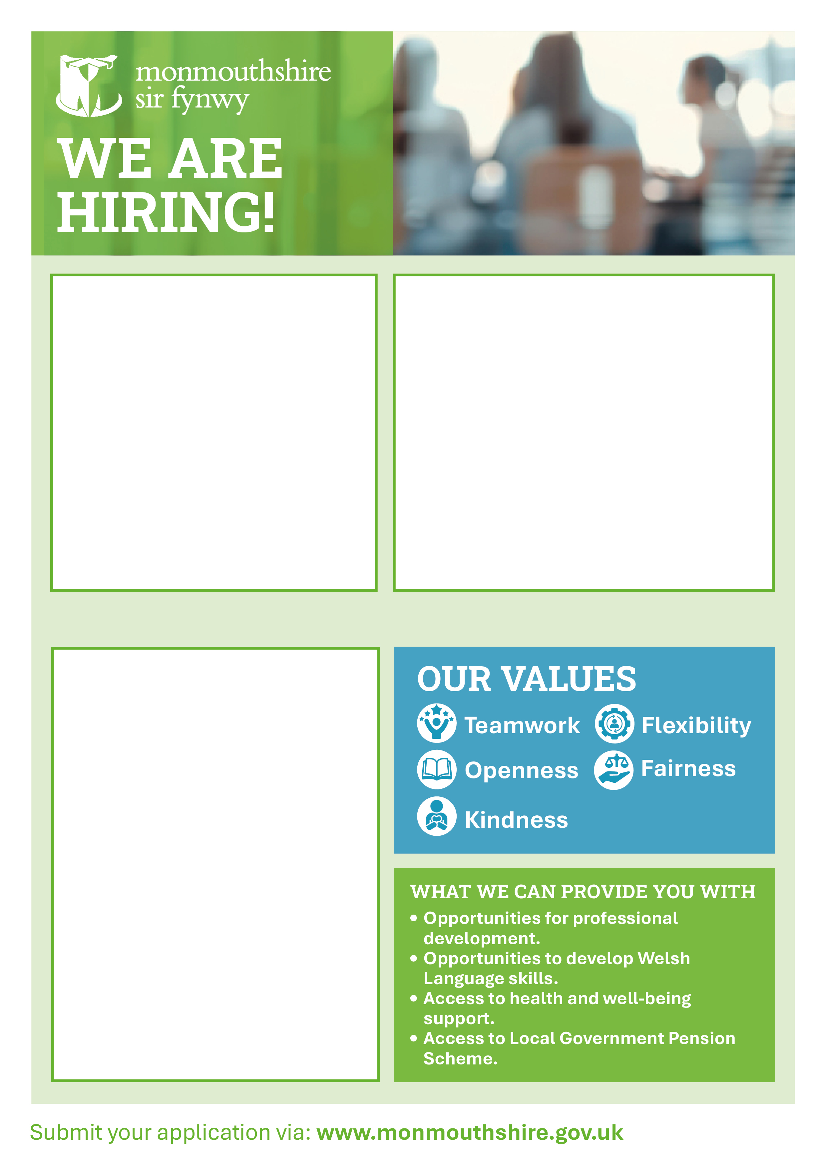
Work Experience Placement
Information Assistant
LOCATION: Various across Monmouthshire
SALARY: Real living wage
HOURS: 22.2 hours per week
CONTRACT: 6 weeks, commencing 20th July 2026
WORK PATTERN: To be decided with hiring manager
DBS CHECK: Dependent on role
Requirements:18-24 years old, Monmouthshire Resident
Kickstart your career and make a real difference in your community with this work experience placement as an Information Assistant! Based in a friendly community hub, you’ll be at the heart of the action - welcoming people, helping them access services, supporting library activities, and showing customers how to use digital tools. If you’re outgoing, motivated, and enjoy working with people from all walks of life, this is your chance to build confidence, gain new skills, and be part of a team that helps others learn, connect, and thrive.
Who are we???
We’re more than a library - we’re a buzzing Community Hub at the heart of local life. It’s where people come to learn, connect, get support, and discover new opportunities every day. From helping someone get online for the first time to supporting community events and learning activities, our team makes a real difference. If you want to be part of something meaningful, fast-paced, and people-focused - this is the place to start your journey.
WHAT WE CAN PROVIDE YOU WITH
A paid 6-week work experience placement
Workplace skills
Opportunities for professional development

Slide 2

Step into a role that puts you at the center of your community—gaining practical experience, growing your confidence, and picking up skills that will set you apart as you take on a variety of real-world tasks. Please find a selection of the key activities that you would get involved in:
Welcoming customers and being the first friendly face people see when they enter the Community Hub.
Helping people find information and services, answering questions and guiding them to the right support.
Supporting library activities, including shelving books, managing loans, and assisting with memberships.
Assisting customers with computers and digital tools, helping them get online or use software confidently.
Providing excellent customer service, making sure everyone receives a helpful, respectful, and positive experience.
Handling day-to-day enquiries, taking ownership of questions and seeing them through to a solution.
Supporting community activities and events, helping deliver engaging sessions inside and outside the hub.
Working as part of a team, collaborating with staff to deliver a smooth and effective service.
Carrying out basic admin tasks, such as record keeping, processing payments, and updating systems.
Promoting services and opportunities, helping raise awareness of what the hub offers and encouraging community involvement.

